Slide 1
QUIZ 2
Please put everything away and out of sight except pens and paper. On top of your paper, write your full name, Art 112 or 212, and today’s date.

Slide 2
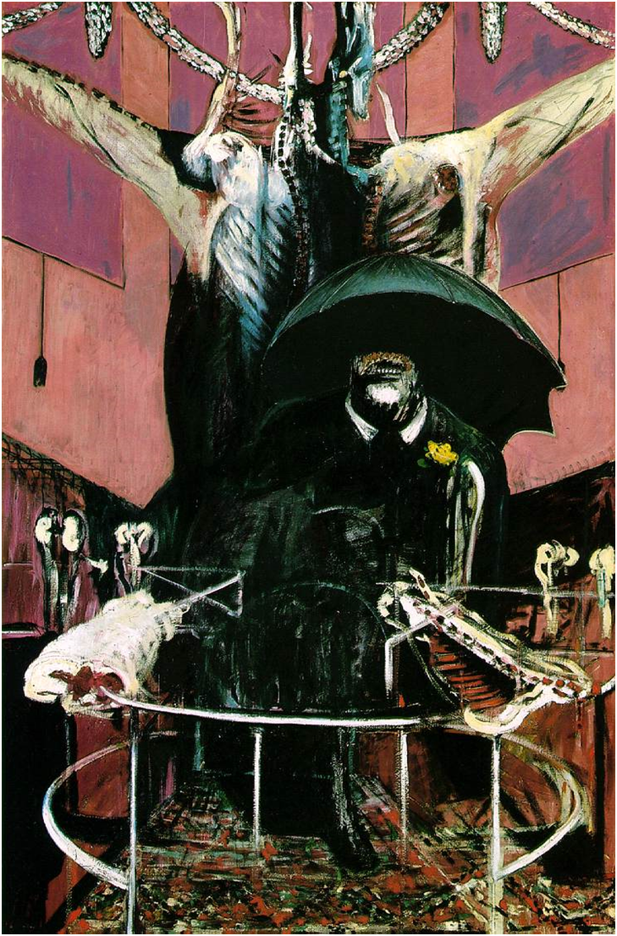
Identify: 1) Artist’s full name and nationality 2) title, 3) date, 4) medium, 5) movement Short essay: Explain how the artwork, in form and content, is representative of the paradigm shift (c. the 1930s-50s) from the Modern to the Postmodern. How is it “post-humanist”? (Remember that “form” is the artist’s use of the elements/language of art: color, line, value (light/dark), scale, texture, etc. Form also includes medium. “Content” is the subject and meaning (artist’s intended meaning). 10 minutes

Slide 3
Identify: 1) Artist’s full name and nationality 2) title, 3) date, 4) medium, 5) movement Short essay: How is this work influenced by Abstract Expressionism? Consider form and content: the subject, the artist’s intended meaning, their formal choices, including the medium (all materials used) and their method of making. 10 minutes

Slide 4
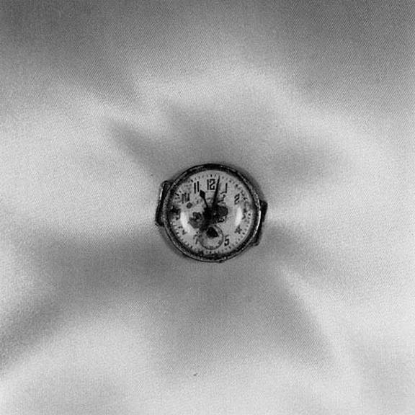
Identify: 1) Artist’s full name and nationality 2) title, 3) date, 4) medium, 5) movement Question: Where was this image made and what story does it tell? 5 minutes

